Slide 1
Deep Reinforcement Learning from Human Preferences - Paper Review
Nikhil Challa
Masters in Machine Learning, Systems, and Control
Lund University

Slide 2
Introduction
Reinforcement Learning (RL)
State, Action, Goal, Reward function, Policy
Real-world challenges
Goal, Reward function, Policy
How do you learn complex task from someone else?
Can you show me…
Notes:
We, humans, have a way of communicating via hands, language, etc. We don’t have that interface luxury when it comes to a SW based agent

Slide 3

Example of real-world challenges
Objective: Peel a carrot
Agent: My hand
Goals are complex, poorly defined, and hard to specify
E.g. Surface of a carrot must be consistently orange
Reward function doesn't always satisfy our preferences
E.g. Reward if something comes off the carrot
Notes:
Poor Goal : How to distinguish surface color, say if your carrot is darker or yellow or contains non-uniform coloration.
Bad Reward : You would keep peeling the carrot until nothing is left

Slide 4

What if the agent could show you?
You (human) select the desired behavior
Notes:
Agent shows you a pair of clips
Human performs a comparison
Agent extracts reward function using inverse RL
Train an agent with reinforcement learning. (imitation learning)

Slide 5
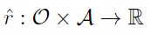
Terminology Alert
Trajectory: Set of observations and actions
Trajectory 1 is preferred over 2
Reward function estimate
Policy

Slide 6



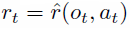
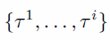


Sequence of Steps – Process 1
(Eg. A2C with multiple sync workers) to find the policy that maximizes the sum of predicted rewards
Policy interacts with the environment
to product trajectories
Notes:
A2C: Advantage Actor-Critic
TRPO: Trust Region Policy Optimization

Slide 7

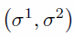
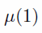
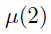
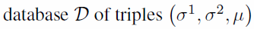
Sequence of Steps – Process 2
Not Comparable
1
2
Pairs of segments from trajectories
Human make comparisons
Human judgments recorded in

Slide 8
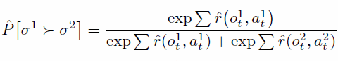
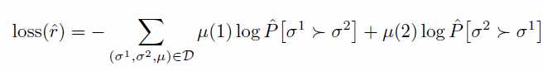
Sequence of Steps – Process 3
Choose to minimize cross-entropy loss; fit the reward function to human preferences

Slide 9
Asynchronous
Process 1
Process 2
Process 3
Notes:
Chicken egg problem: We start with a randomly initialized policy.
A subtle difference with legacy RL methods, we use predicted rewards instead of real rewards…

Slide 10
Comparison / Benchmarking
How do we make a comparison, is it worth it?
s
Three types of learning comparisons
Human feedback
Feedback varies from person to person
Synthetic oracle feedback
Feedback using rewards from tasks
RL training with real reward
Uses DQN
Learn the rewards
Learn the rewards
Has published benchmarks
Objective is to do nearly as well as RL with a real reward
Notes:
Human feedback can tend to be varying in nature depending on how many different humans provided the comparison results for the same data
Synthetic oracle feedback is nearly consistent

Slide 11
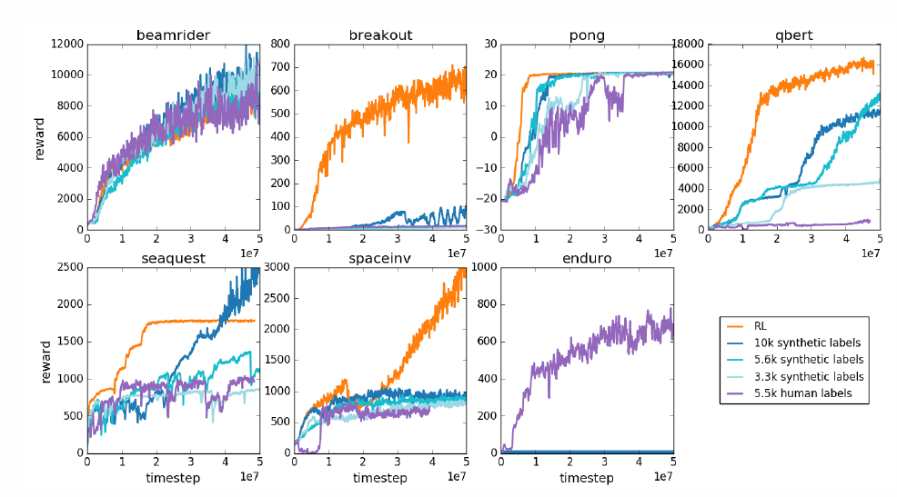
Review of Experiments (Atari Games)
Notes:
To justify the usability, you need a benchmark or platform to compare new methods with existing ones.
They picked a few games from Atari, where RL learning was possible, as in using real, easily definable rewards.
Compared with human label to see if it is possible to get comparable performance.

Slide 12
Thank you
Notes:
Value-Based vs Policy Based
This is simple, its Actor-Critic and so mix of both
Model-Based vs Model-Free
We don’t have transition probabilities, but direct access to the environment
We use Actor-Critic
Hence Model Free
Online vs Offline
This is a bit tricky, the agent interacts with the environment to get trajectories, but we don’t use the reward from the environment directly.
The reward is estimated via expert classification.
I would still place it as Online Learning (interaction with environment + RL based)
Off-policy vs on-policy
its an on-policy. You use stochastic nature of policy function, and using multiple workers you get diversity

